Slide 1
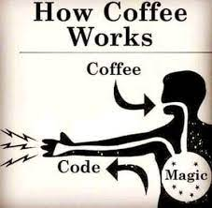

Rossman Store Sales Mini Competition
DSR Batch 28 – Team 3
By Jose Javier Rico Soldado, Eero Olli & Hazel Wat

Slide 2
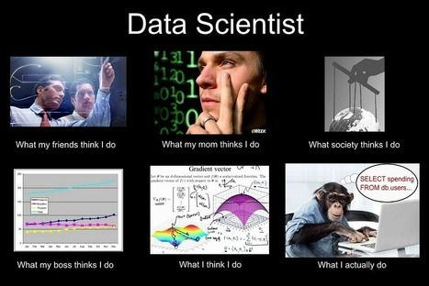

Slide 3
Appproach:
1. First off, split the data (Best Practice)
Test : 20 %; Train: 80%
2. Clean the data
3. Model execution
Method:
Linear Regressor
Random Forest
FB Prophet
XGB Boost

Slide 4
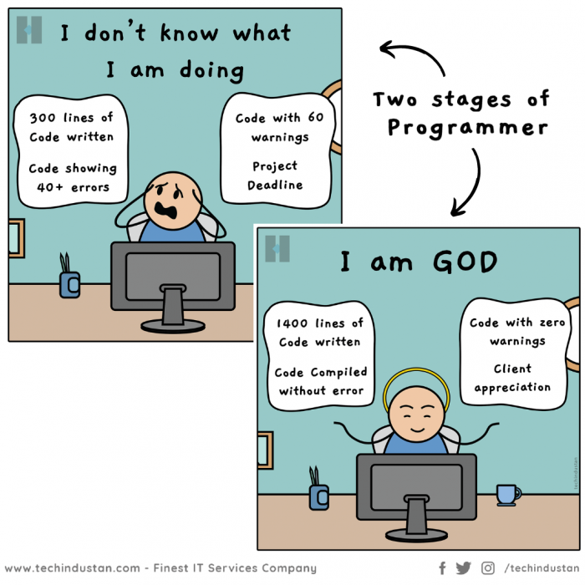
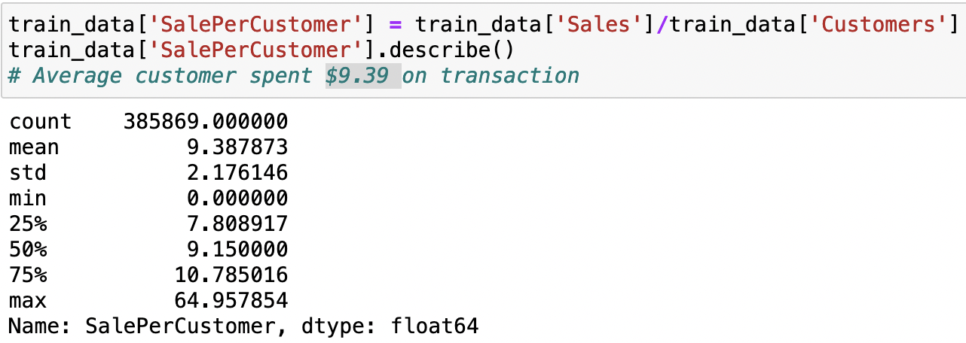
Interesting facts:
There is 33 records that showed store were opened but no sales.
Average customer spent 9.39EUR per transaction

Slide 5
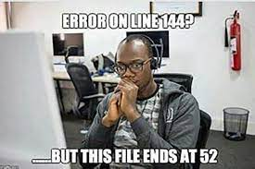
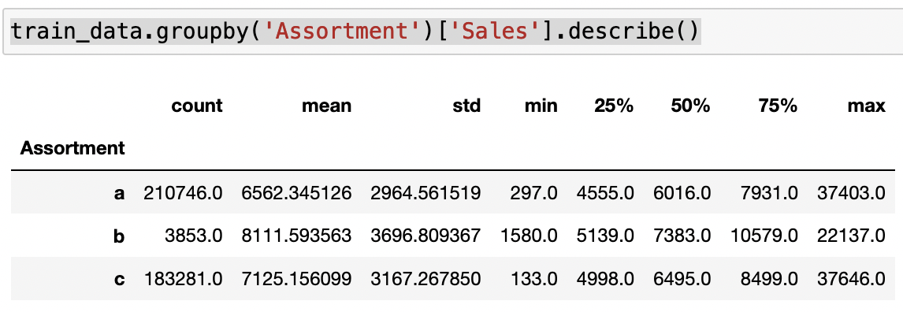
More founding:
- Assortment Type B (Extra) has more sales than Type A(Basis) & Type C (Extended) stores on average

Slide 6
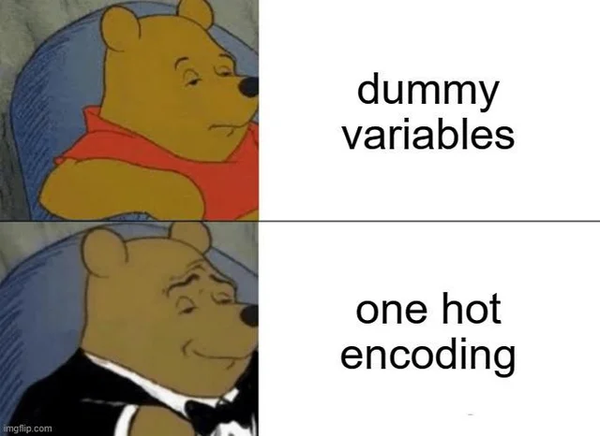
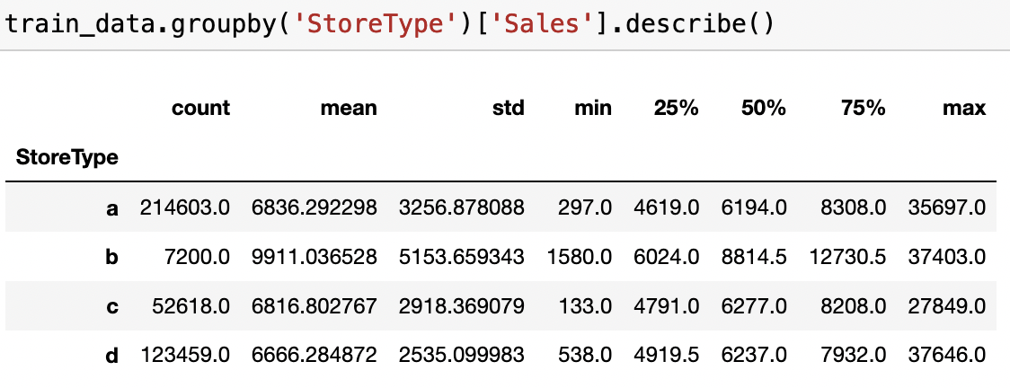
Foundings:
- Type B stores has a lot more sales (9911 EUR) than other store stpes on average

Slide 7
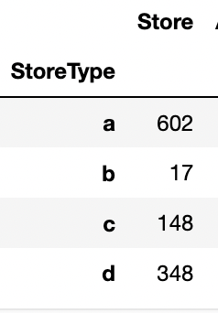
Distribution of store types

Slide 8
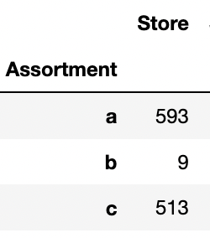
Distribution of Assortment
a = basis
b = extra
c = extended

Slide 9
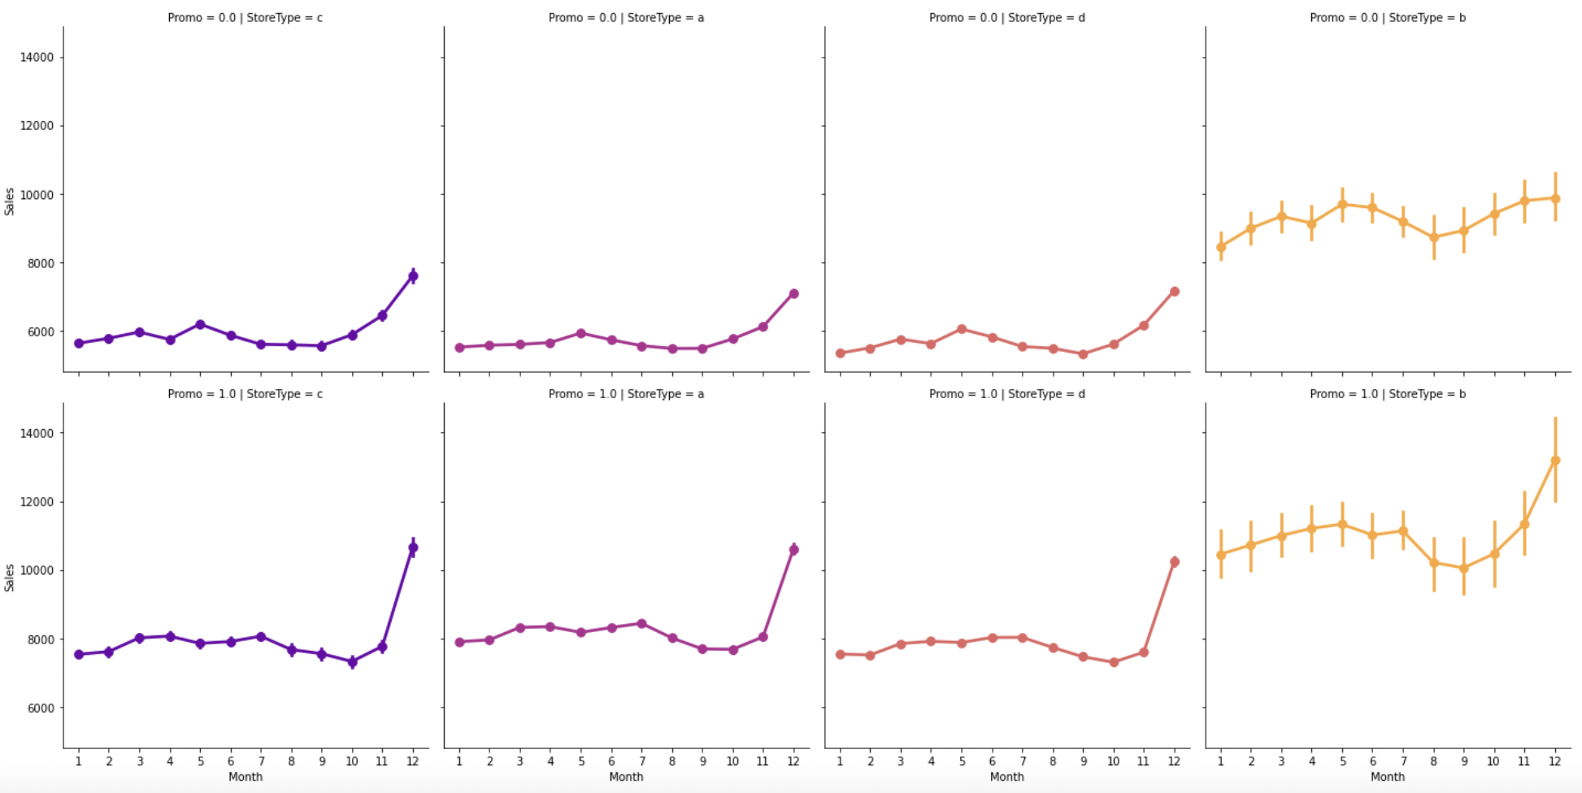
Performance of Store Types with/without Promo (Year) c, a, d & b

Slide 10
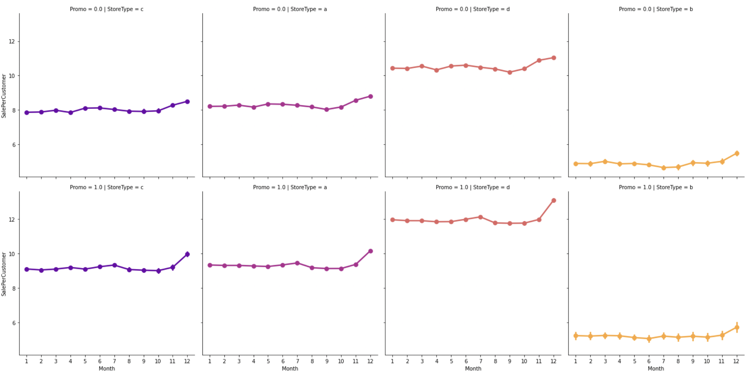
Average customer sales with/without Promo (Year) c, a, d, b

Slide 11
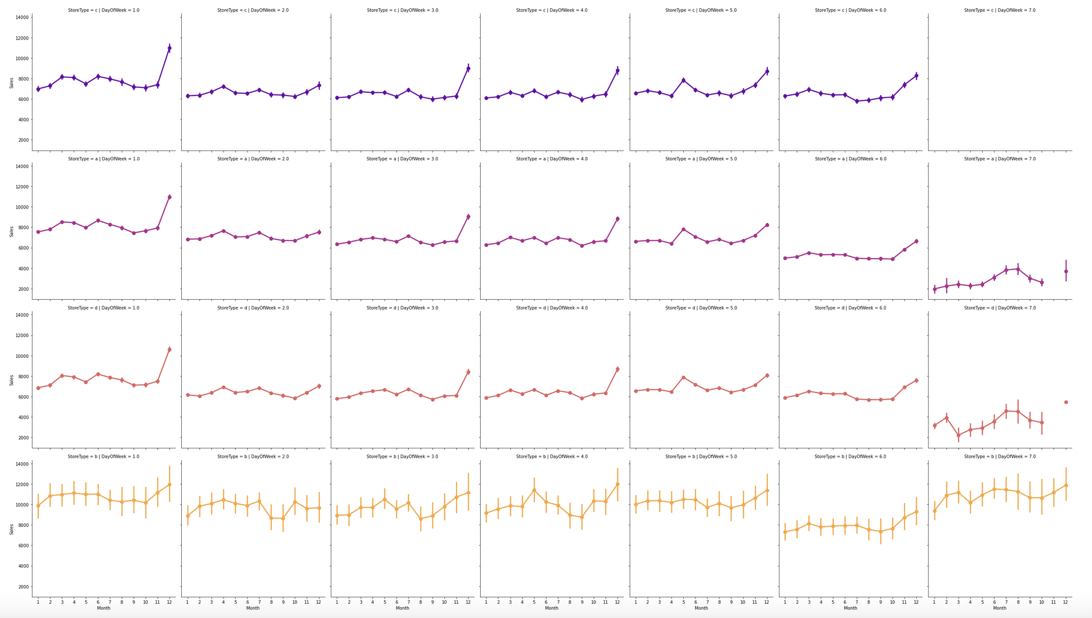
Average Sales per Store Type per month (Type c, a, d & b) (Weekly data – Mon, Tue, Wed, Thu, Fri, Sat & Sun) )

Slide 12
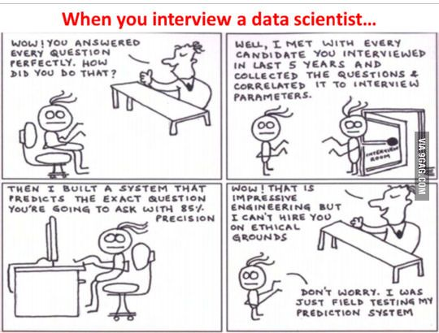

Slide 13
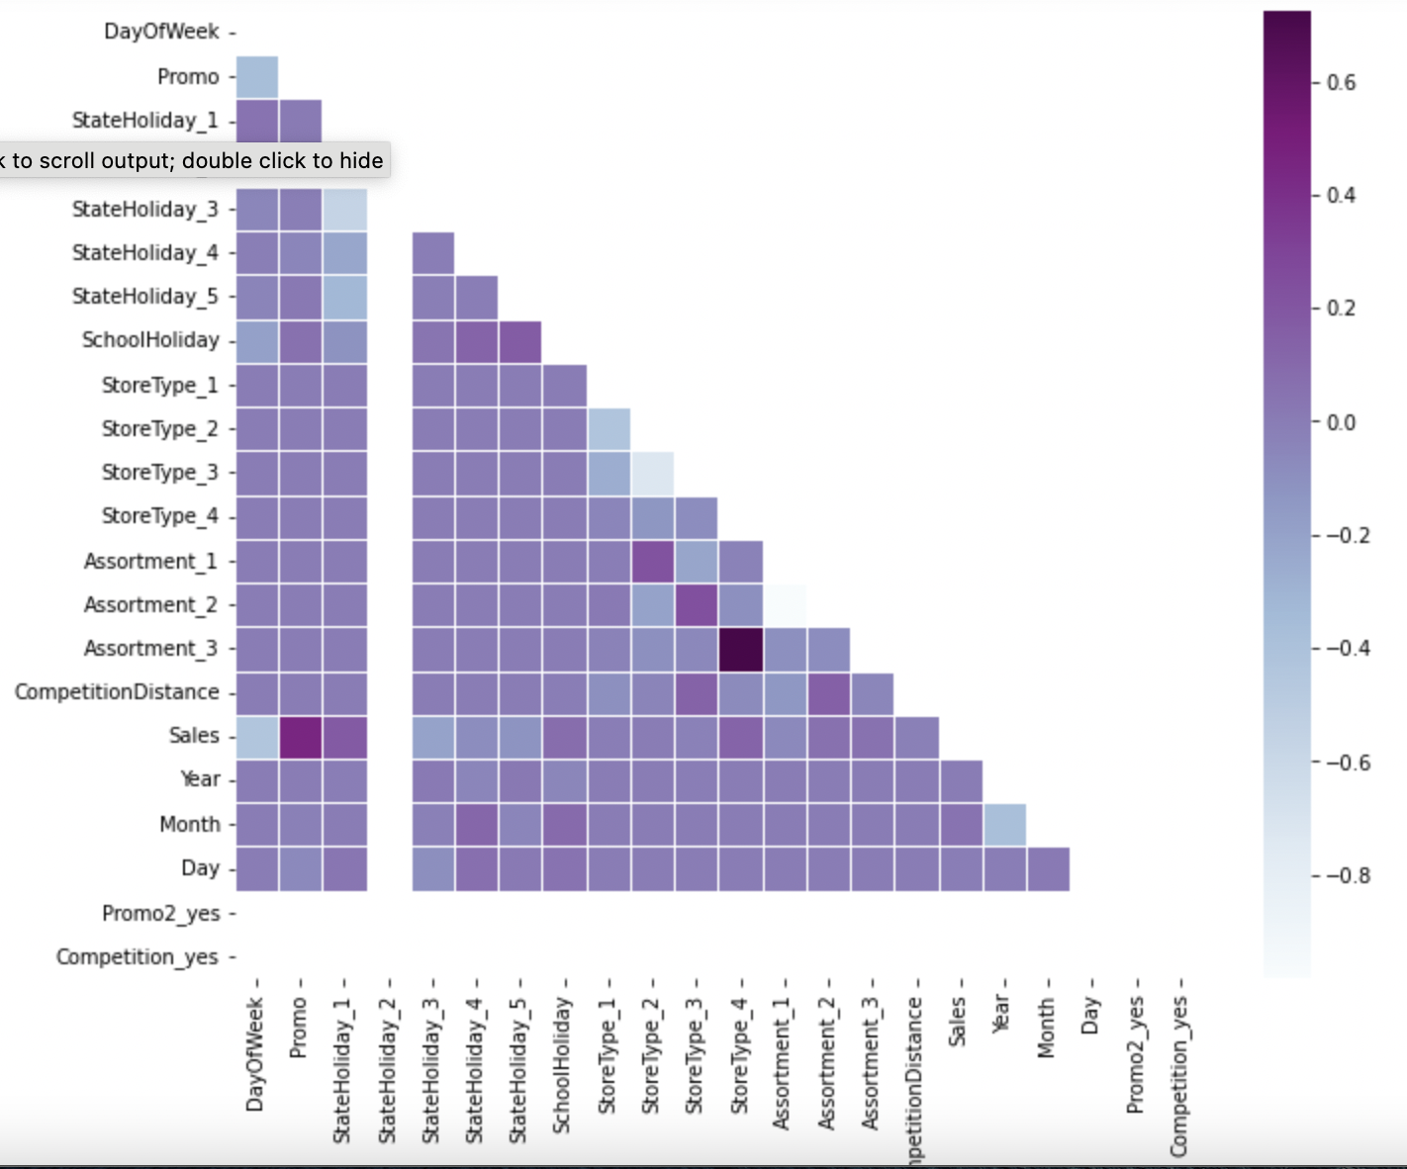
Correlation between different columns

Slide 14
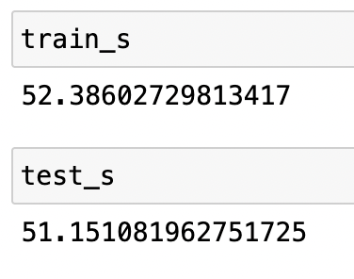
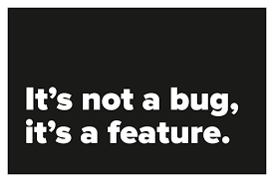
Linear Regression
Results:

Slide 15
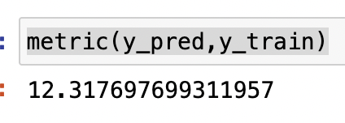
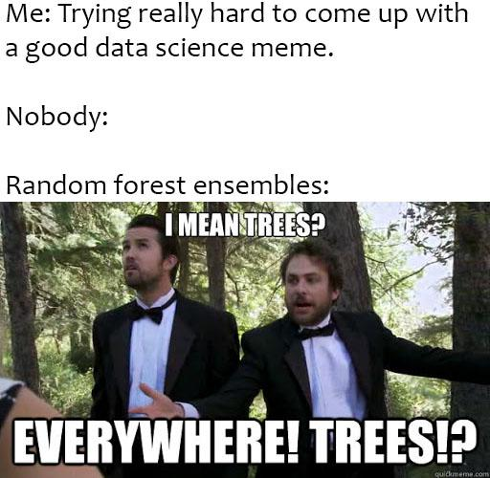
Random Forest

Slide 16
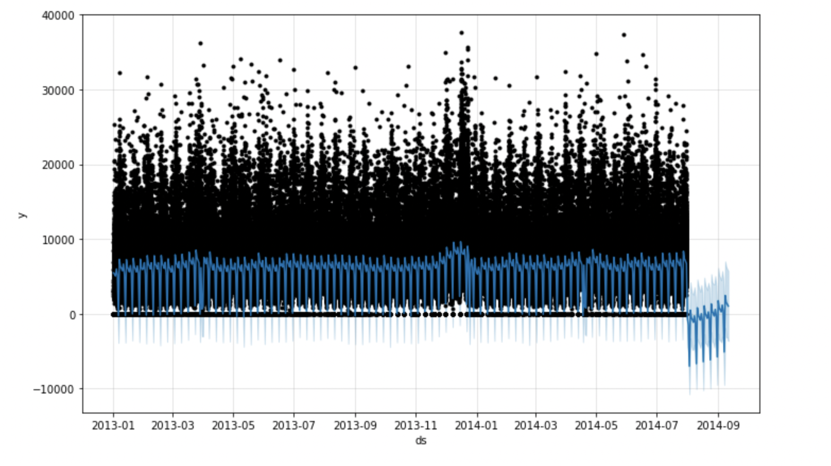
FB Prophet

Slide 17
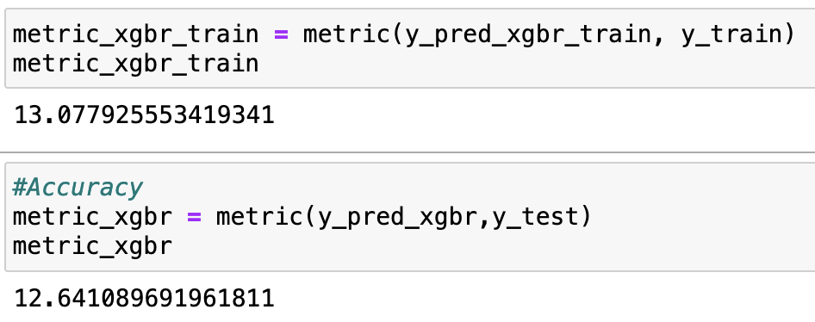

Boost Gradient

Slide 18
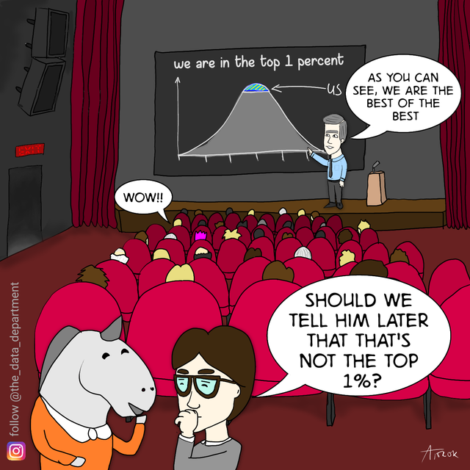

Slide 19
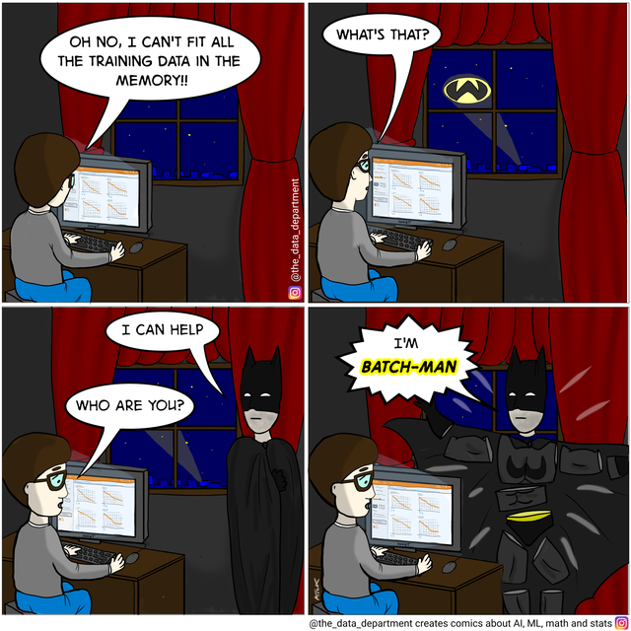


Slide 20

The End.

